Slide 1
Finding the Subnet, Broadcast and Useable Host Ranges
Lecture 8
Routing Algorithms: Shortest Path Routing

Slide 2
Connectionless and connection-oriented Service
Connection-oriented service is modelled after the telephone system. To talk to someone, you pick up the phone, dial the number, talk, and then hang up. Similarly, to use a connection-oriented network service, the service user first establishes a connection, uses the connection, and then releases the connection. The essential aspect of a connection is that it acts like a tube: the sender pushes objects (bits) in at one end, and the receiver takes them out at the other end. In most cases the order is preserved so that the bits arrive in the order they were sent.

Slide 3
Cont.
In contrast to connection-oriented service, connectionless service is modelled after the postal system. Each message (letter) carries the full destination address, and each one is routed through the intermediate nodes inside the system independent of all the subsequent messages.

Slide 4
Virtual-Circuit and Datagram Networks
Two different organizations are possible, depending on the type of service offered.
If connectionless service is offered, packets are injected into the network individually and routed independently of each other.
No advance setup is needed. In this context, the packets are frequently called datagrams (in analogy with telegrams) and the network is called a datagram network.
If connection-oriented service is used, a path from the source router all the way to the destination router must be established before any data packets can be sent.
This connection is called a VC (virtual circuit), in analogy with the physical circuits set up by the telephone system, and the network is called a virtual-circuit network.

Slide 5
Routing within a datagram network
Each packet is treated independently, with no reference to packets that have gone before.
Packets can take any possible route.
Packets may arrive at the receiver out of order.
Packets may go missing.
It is up to the receiver to re-order packets and recover from missing packets.
Example: Internet

Slide 6
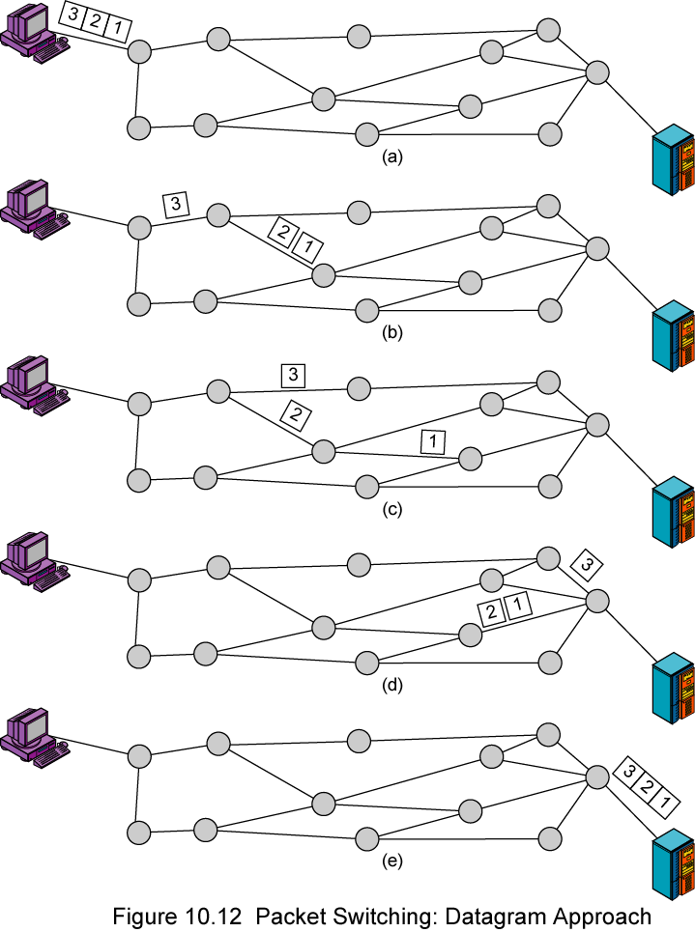
Cont.

Slide 7
Routing within a virtual-circuit network
In virtual circuit, a preplanned route is established before any packets are sent, then all packets follow the same route.
Each node on the pre-established route knows where to forward such packets.
  The node need not make a routing decision for each packet.
Example: X.25, Frame Relay, ATM

Slide 8
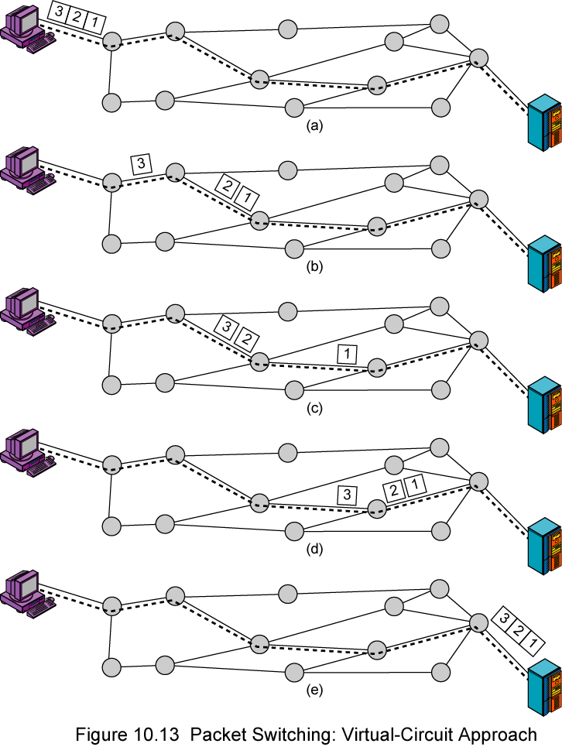
Cont.

Slide 9
Virtual Circuits versus Datagram
Virtual circuits
  Network can provide sequencing (packets arrive at the same order) and error control (retransmission between two nodes).
  Packets are forwarded more quickly
    No routing decisions to make
  Less reliable
    If a node fails, all virtual circuits that pass through that node fail.

Slide 10
Virtual Circuits versus Datagram Cont.
Datagram
  No call setup phase
    Good for bursty data, such as Web applications
  More flexible
    If a route fails, packets may find an alternate route
    Routing can be used to avoid congested parts of the network

Slide 11
Routing
The main function of the network layer is routing packets from the source machine to the destination machine. In most networks, packets will require multiple hops to make the journey.
The routing algorithm is that part of the network layer software responsible for deciding which output line an incoming packet should be transmitted on.
If the network uses datagrams internally, this decision must be made anew for every arriving data packet since the best route may have changed since last time.

Slide 12
Routing
If the network uses virtual circuits internally, routing decisions are made only when a new virtual circuit is being set up. Thereafter, data packets just follow the already established route. The latter case is sometimes called session routing because a route remains in force for an entire session.

Slide 13
Routing-Cont.
It is sometimes useful to make a distinction between routing, which is making the decision which routes to use, and forwarding, which is what happens when a packet arrives.
One can think of a router as having two processes inside it.
  One of them handles each packet as it arrives, looking up the outgoing line to use for it in the routing tables. This process is forwarding.
  The other process is responsible for filling in and updating the routing tables. That is where the routing algorithm comes into play.

Slide 14
Goals of routing
Correctness: The routing should be done properly and correctly so that the packets may reach their proper destination.
Simplicity: The routing should be done in a simple manner so that the overhead is as low as possible. With increasing complexity of the routing algorithms the overhead also increases.
Robustness: Once a major network becomes operative, it may be expected to run continuously for years without any failures. The algorithms designed for routing should be robust enough to handle hardware and software failures and should be able to cope with changes in the topology and traffic without requiring all jobs in all hosts to be aborted and the network rebooted every time some router goes down.

Slide 15
Goals of routing-Cont.
Stability: The routing algorithms should be stable under all possible circumstances.
Fairness: Every node connected to the network should get a fair chance of transmitting their packets. This is generally done on a first come first serve basis.
Optimality: The routing algorithms should be optimal in terms of throughput and minimizing mean packet delays. Here there is a trade-off and one has to choose depending on his suitability.

Slide 16
INTER- AND INTRA-DOMAIN ROUTING
Today, an internet can be so large that one routing protocol cannot handle the task of updating the routing tables of all routers. For this reason, an internet is divided into autonomous systems.
An autonomous system (AS) is a group of networks and routers under the authority of a single administration. Routing inside an autonomous system is called intra-domain routing.
Routing between autonomous systems is called inter-domain routing.

Slide 17
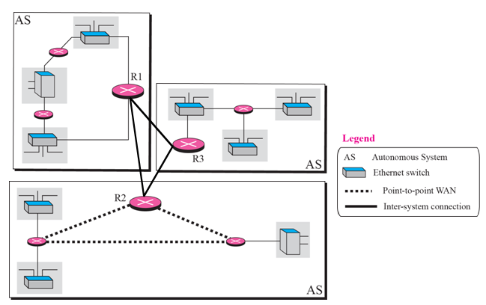
Cont.

Slide 18
Nonadaptive and adaptive Routing algorithm
Nonadaptive algorithms do not base their routing decisions on any measurements or estimates of the current topology and traffic. Instead, the choice of the route to use to get from I to J (for all I and J) is computed in advance, offline, and downloaded to the routers when the network is booted. This procedure is sometimes called static routing. Because it does not respond to failures,
Adaptive algorithms, in contrast, change their routing decisions to reflect changes in the topology, and sometimes changes in the traffic as well.

Slide 19
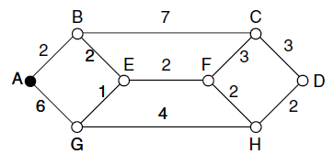
Shortest-Path Routing
The idea is to build a graph of the network, with each node of the graph representing a router and each edge of the graph representing a communication line, or link.
To choose a route between a given pair of routers, the algorithm just finds the shortest path between them on the graph.
One way of measuring path length is the number of hops. Using this metric, the paths ABC and ABE in Figure below are equally long.
Another metric is the geographic distance in km, in which case ABC is clearly much longer than ABE (assuming the figure is drawn to scale).

Slide 20
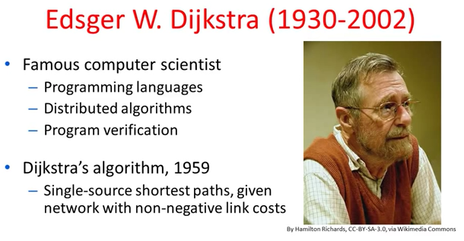
Dijkstra’s shortest-path algorithm (1959)

Slide 21
Dijkstra’s shortest-path algorithm (1959)
Each node is labeled (in parentheses) with its distance from the source node along the best known path.
As the algorithm executes, nodes are labeled with its distance to source along best known path.
Initially, no routes known, so all nodes are labeled with infinity.
Labels change as the algorithm proceeds.
Labels can be temporary or permanent.
  Initially all labels are tentative.
  A label becomes permanent if it represents the shortest path from the source to the node.

Slide 22
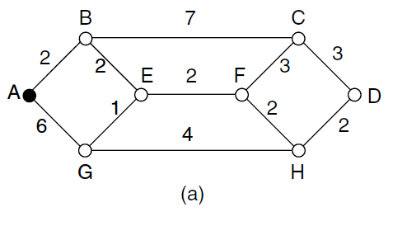
Cont.
To illustrate how the labeling algorithm works, look at the weighted, undirected graph of Fig. (a), where the weights represent, for example, distance. We want to find the shortest path from A to D.

Slide 23
Cont.
We start out by marking node A as permanent, indicated by a filled-in circle.
Then we examine, in turn, each of the nodes adjacent to A (the working node), relabeling each one with the distance to A.
Whenever a node is relabeled, we also label it with the node from which the probe was made so that we can reconstruct the final path later.
If the network had more than one shortest path from A to D and we wanted to find all of them, we would need to remember all of the probe nodes that could reach a node with the same distance.

Slide 24
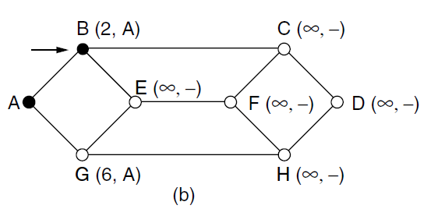
Cont.
Having examined each of the nodes adjacent to A, we examine all the tentatively labelled nodes in the whole graph and make the one with the smallest label permanent, as shown in Fig. below. This one becomes the new working node.

Slide 25
Cont.
We now start at B and examine all nodes adjacent to it. If the sum of the label on B and the distance from B to the node being considered is less than the label on that node, we have a shorter path, so the node is relabelled.
After all the nodes adjacent to the working node have been inspected and the tentative labels changed if possible, the entire graph is searched for the tentatively labelled node with the smallest value.
This node is made permanent and becomes the working node for the next round.

Slide 26
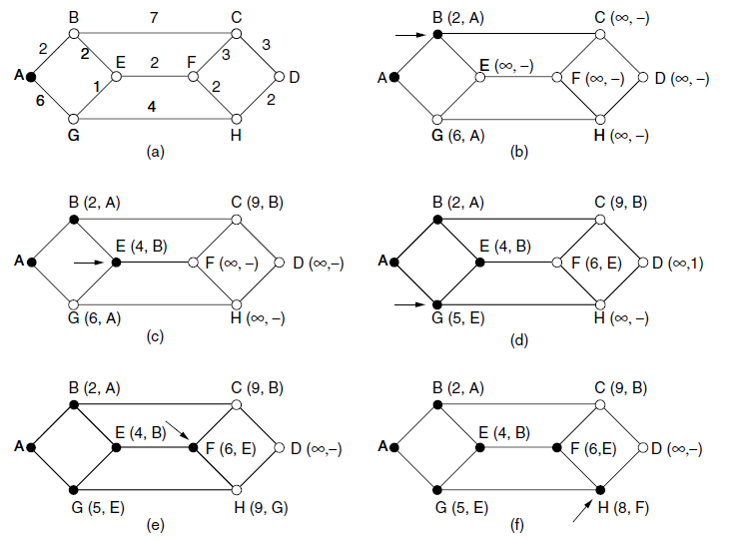
Cont.

Slide 27
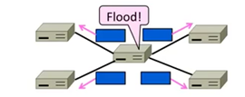
Flooding
Flooding is a simple computer network routing algorithm in which every incoming packet is sent through every outgoing link except the one it arrived on.
Inefficient because one node may receive multiple copies of message.

Slide 28
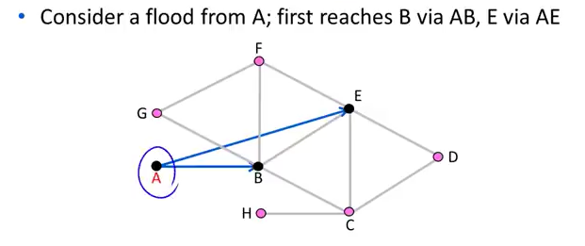
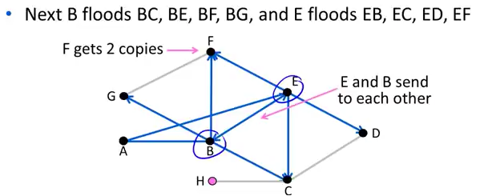
Flooding-Cont.

Slide 29
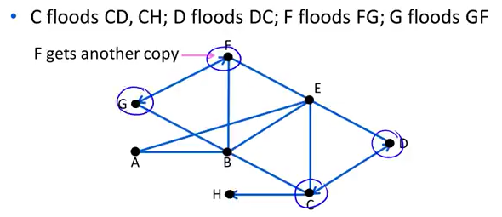
Flooding-Cont.

Slide 30
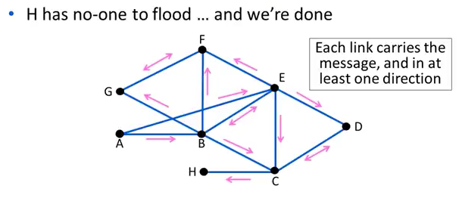
Flooding-Cont.

Slide 31
Flooding-Cont.
A technique for damming the flood is to have routers keep track of which packets have been flooded, to avoid sending them out a second time.
One way to achieve this goal is to have the source router put a sequence number in each packet it receives from its hosts. Each router then needs a list per source router telling which sequence numbers originating at that source have already been seen. If an incoming packet is on the list, it is not flooded.

Slide 32
Flooding-Cont
Flooding is not practical for sending most packets, but it does have some important uses.
First, it ensures that a packet is delivered to every node in the network. This may be wasteful if there is a single destination that needs the packet, but it is effective for broadcasting information. In wireless networks, all messages transmitted by a station can be received by all other stations within its radio range, which is, in fact, flooding, and some algorithms utilize this property.
Second, flooding is tremendously robust. Even if large numbers of routers are blown to bits (e.g., in a military network located in a war zone), flooding will find a path if one exists, to get a packet to its destination.

Slide 33
Flooding-Cont
Flooding also requires little in the way of setup. The routers only need to know their neighbours. This means that flooding can be used as a building block for other routing algorithms that are more efficient but need more in the way of setup.
Flooding can also be used as a metric against which other routing algorithms can be compared. Flooding always chooses the shortest path because it chooses every possible path in parallel. Consequently, no other algorithm can produce a shorter delay (if we ignore the overhead generated by the flooding process itself).

